Slide 1

Attendance Tracker
Group Members
Orvell Ferreira (8671)
Clint Ferreira (8670)
Parva Juthani (8674)

Slide 2
Abstract
Successful industries, schools, universities begin by engaging students and making sure that they will come regularly so the attendance rate become very important. The attendance is important because students are more likely to succeed in academics when they attend class consistently. It’s difficult for the lecturer to build students' skills and progress if a large number of students are frequently absent. Marking attendance in the class meeting session and recording the marks of the students are the prime tasks of the subject handlers, since marking the attendance can regulate the students to attend the classes. Moreover, it verifies number of students present in the conducted classes. The purpose of recording the marks is to analyse the performance of the students in terms of curricular activities. Earlier, the tasks of marking attendance and recording the marks are handled manually by pen and paper method. This method consumes more time and adds more workload to the subject handlers and sometimes the data may prone to error. To avoid these problems, we present a mobile application for student attendance and mark management system.

Slide 3
Objectives
1. This application is mainly designed for the faculties who maintain attendance and marks regularly.
2. Using this system, the subject handlers, staffs or the authorities should be able verify the number of students present or absent in the class meeting sessions.
3. It should be able to allow the faculty members to send an SMS intimation to students of their attendance and alert them if they are a defaulter.

Slide 4
Activities Included
MainActivity - It is front page with where the user will be prompted to start a page and than a login page will appear on the screen.
AddAttendanceActivity - On this page user will get an option to add the attendance of the students.
AddFacultyActivity - On this page admin will have an option to add the faculty members and assign them username and password.
AddStudentActivity - On this page admin will have an option to add the students details.
LoginActivity - In this page there is dropdown with two options one for admin login and another for faculty login where the user will be given options to login using the credentials provided.
MenuActivity - Here the admin will have different options like add faculty/student , view faculty/student, attendance per student, Send messages of attendance to students.
ViewAttendanceActivity - The faculty member can view the attendance of students that they have marked for that selected day.

Slide 5
ViewAttendancePerStudentActivity- Here the admin has the access to view the overall attendance a each student.
ViewFacultyActivity - The admin can view the details of the faculty added by the admin during registration.
ViewStudentActivity - The admin can view the details of the students added by the admin during registration.
DBAdapter - All the database functions that are performed by the app are handled through this activity.All the insertions, retrievals, etc are performed through this activity.

Slide 6
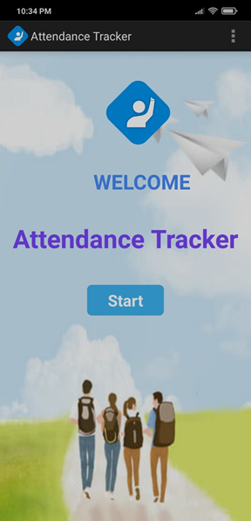
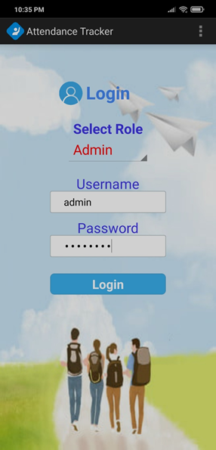
Output Screenshots
On App Start-up Login For Admin

Slide 7
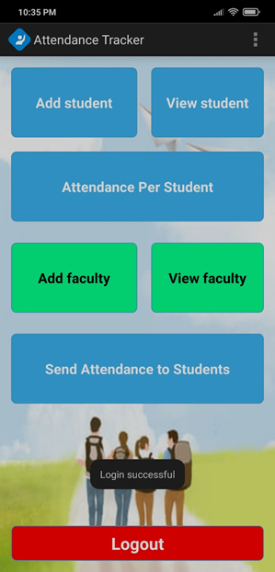
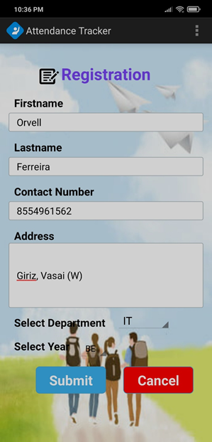
Admin Main Menu Add Student

Slide 8
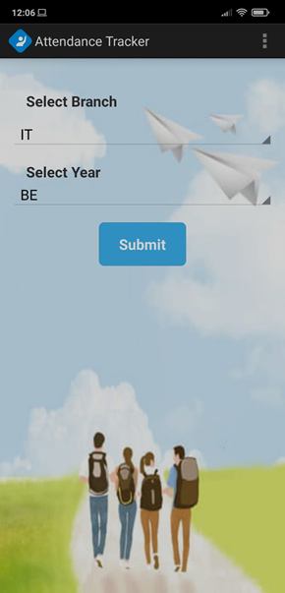
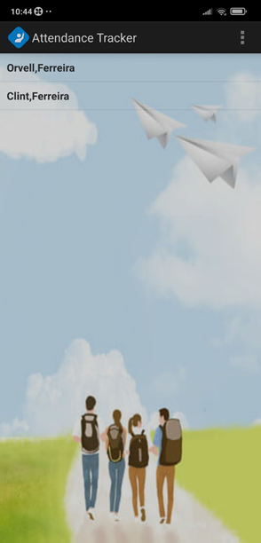
View Student
Select Branch and Year to Display the Students

Slide 9
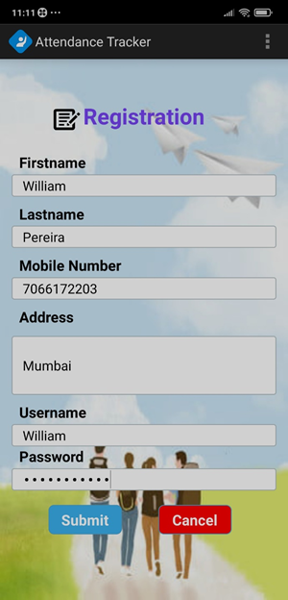
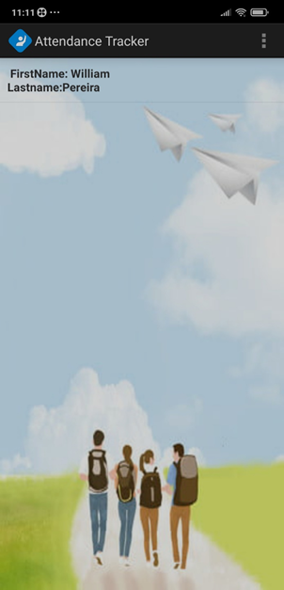
Faculty Registration View Faculty

Slide 10
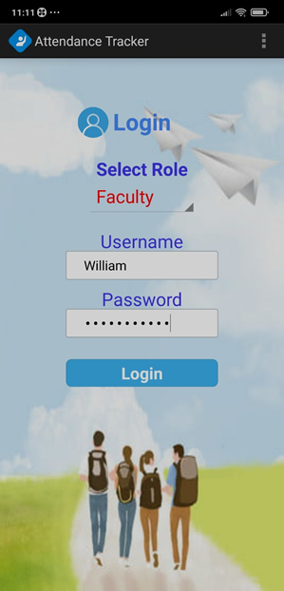
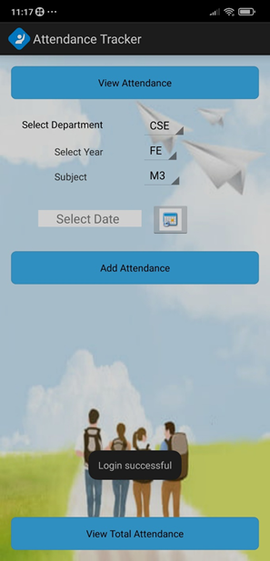
Faculty Login Faculty Menu

Slide 11
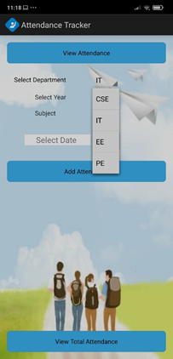
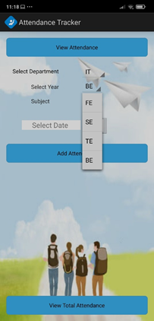
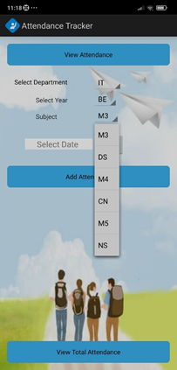
Faculty Dropdowns

Slide 12
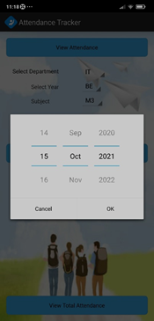
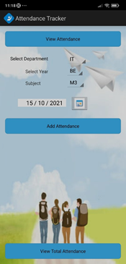

Date Selection and View Students to add Attendance

Slide 13
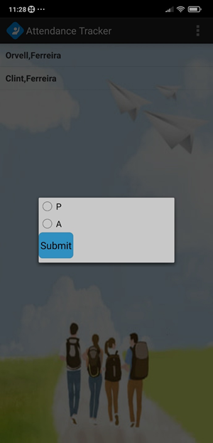
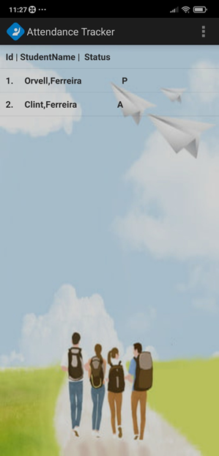
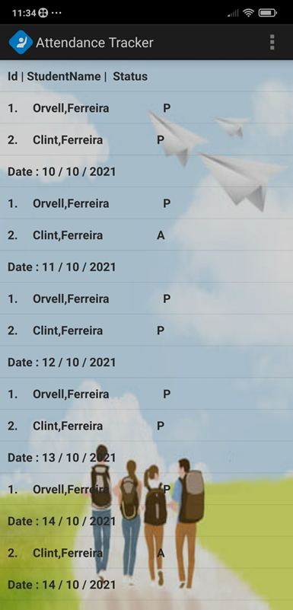
Add Attendance View Attendance View Total Attendance

Slide 14
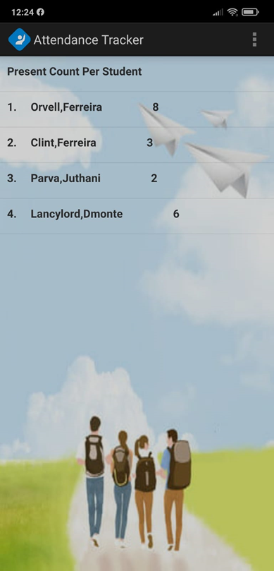
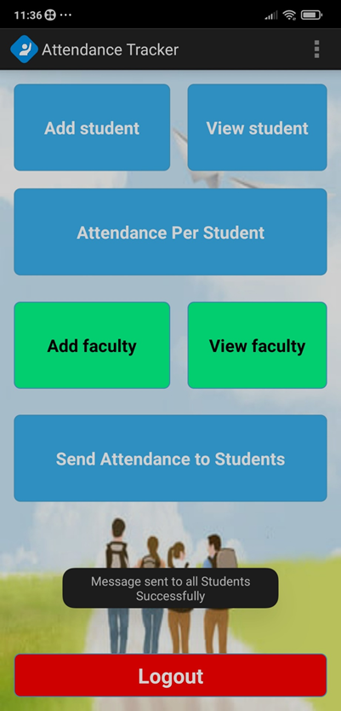
Attendance Per Student at the Admin login
Send SMS Alert of Attendance to Students

Slide 15
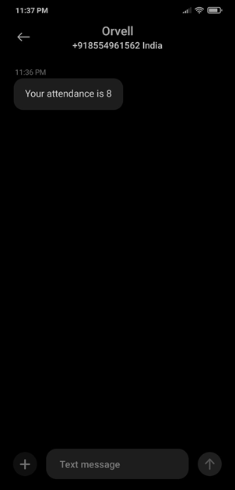
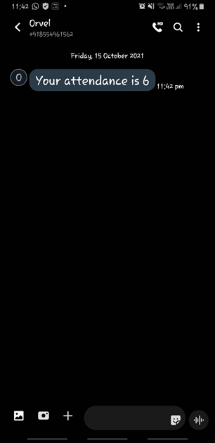
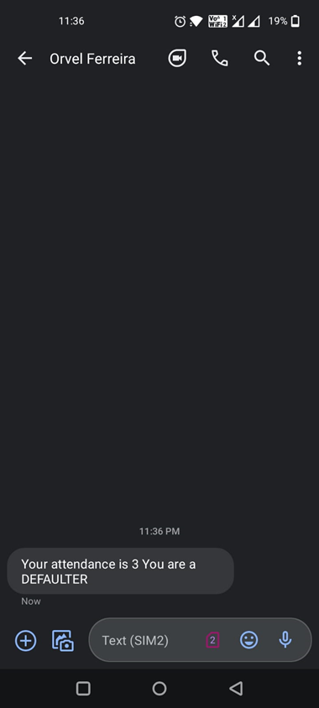
SMS sent to Students
Non-Defaulter Student Defaulters

Slide 16
Conclusion
Thus, we have successfully created an attendance tracking android application. This application will benefit both the faculty and the institution as well. This android application is implemented to reduce the manual process for faculty members. The manual systems which were used traditionally do not serve the user in the best possible way and they can be tedious at times but with our android application the track if the attendance can be kept conveniently and a digital record of the same will be maintained.

Slide 17
References
• https://www.tutorialspoint.com/android/android/user/interface/layouts.html
• https://developer.android.com/guide/topics/media/camera
• https://developer.android.com/studio
• https://www.tutorialspoint.com/android/android_location_based_services.html
• https://www.javatpoint.com/android-tutorial
• https://www.geeksforgeeks.org/android-tutorial

Slide 18
Thank You!!

